Slide 1
Dynamic routing
Routing Algorithm (Dijkstra / Bellman-Ford) – idealization
  All routers are identical
  Network is flat.
    Not true in Practice
Hierarchical routing
  Internet = network of networks
  Each network admin may want to control routing in its own routing network.
  Hierarchical routing solves
    Scale problems.
    Administrative autonomy.

Slide 2
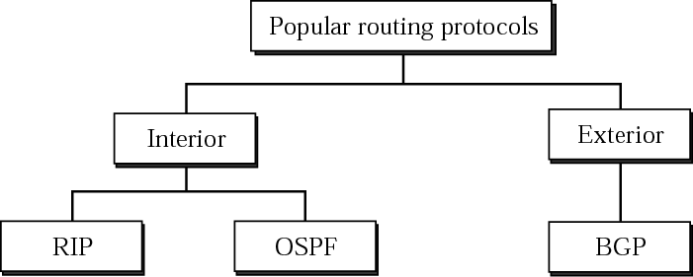
Routing Protocols RIP, OSPF, BGP
Dynamic protocols
  Sharing neighborhood information
Use different metrics.
RIP (one hop count, how many networks a packet crosses), Networks are treated equally
BGP (depend on the policy, set by administrator)
OSPF (TOS, minimize delay, maximize throughput)

Slide 3
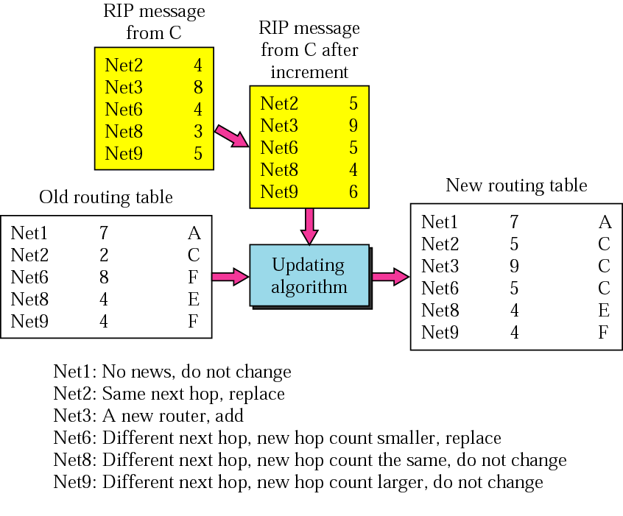
Routing Information Protocol RFC 1058
Receive a RIP message (a response)
Add one hop for each advertised dest
Repeat
  If (dest not in routing table)
    Add the advertised info to the table
  Else
    If (next-hop is the same)
      Replace with the advertised one
    Else
      If (advertised hop count < one in the table)
      Replace entry in the routing table
Return
http://www.faqs.org/rfcs/rfc1058.html
Distance vector algorithm (Bellman-Ford)
  Sharing knowledge about the entire AS
  Shares only with neighbors
  Shares at regular intervals (different from DVA)

Slide 4
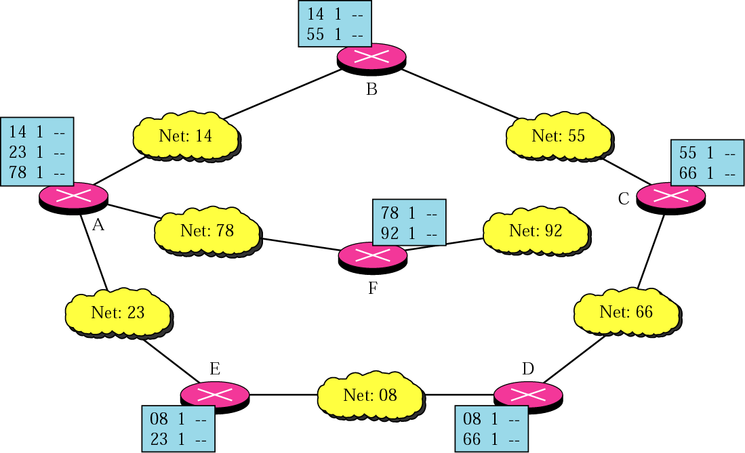
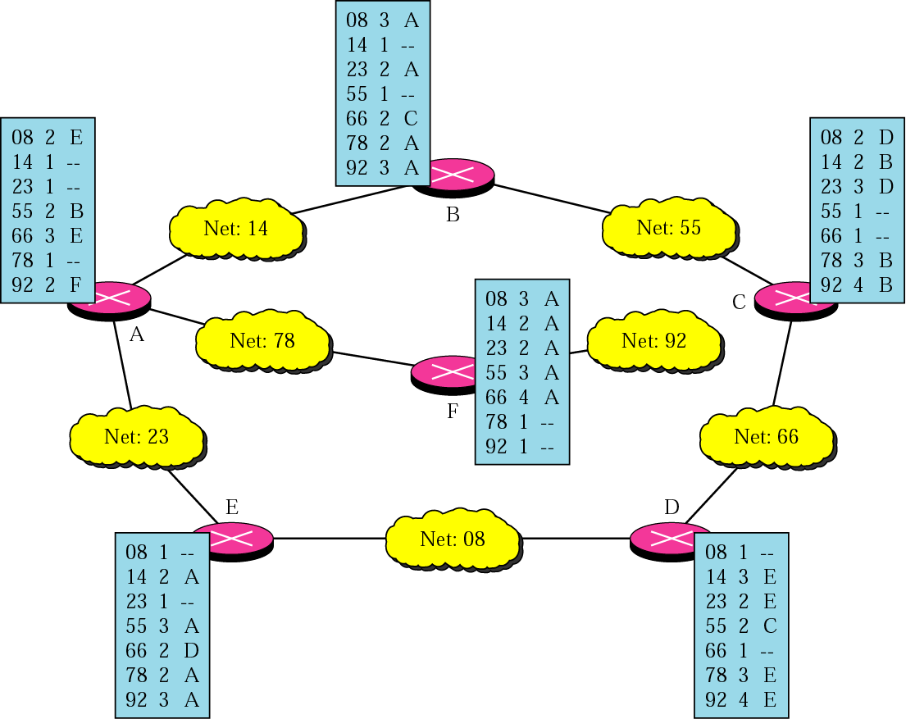
Initializing and Updating Routing Table
Destination Metric Gateway
Dest D G
Rule to implement RIP based in DVA
If Information is not from G
  Update to reflect minimum cost
If Information is from G
  Always update

Slide 5
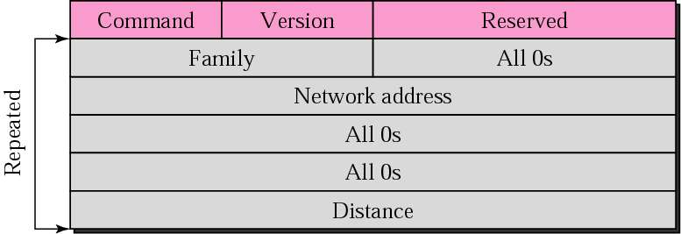
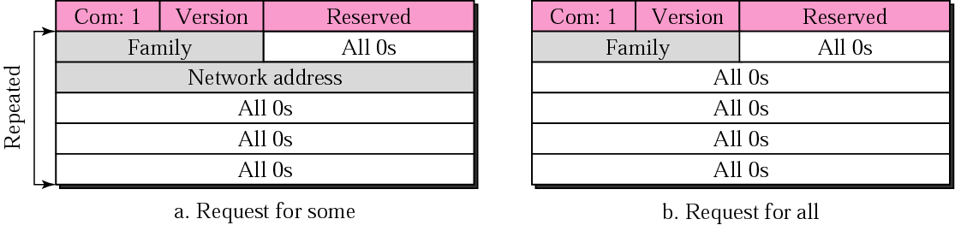
RIP message format
RIP messages uses UDP datagrams on port 520
  Implemented in Unix systems by the ‘routed’ daemon.
Size of datagram limited to 512 bytes (allow advertisement of 25 routes.
Command: 8 bits
  Request (1), reply (2)
Version: 1 or 2
Family: of protocol used for TCP/IP it is 2
Network address : 32 bytes
Distance: hop count from the advertising router to the destination network
Response: solicited or unsolicited.

Slide 6
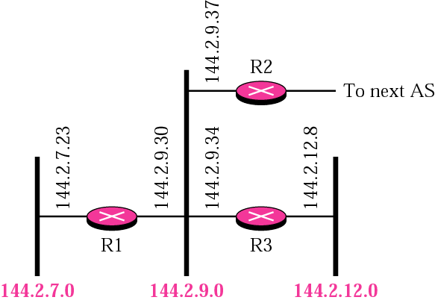
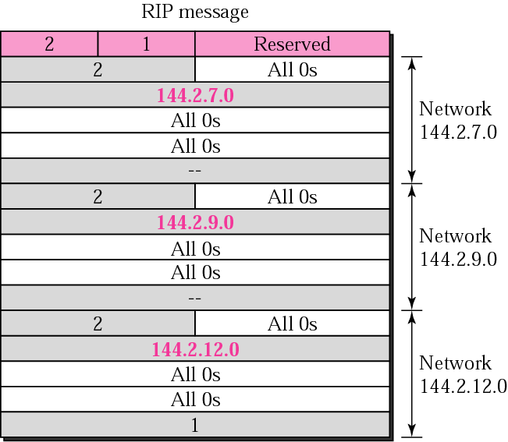
RIP message example

Slide 7
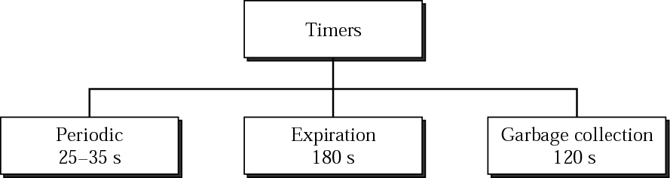
RIP timers
Periodic timer: control advertising of regular update messages (25-35 sec)
Expiration timer: governs the validity of a route (180 sec)
  Every time an update (on a 30 sec average) is received the timer is reset
  If no update received within this timer the metric is set to 16
Garbage timer: 120 sec
  A route can be advertised with a 16 metric for 120 sec before it get purged
    Allow neighbors to have knowledge of the invalidity of a route

Slide 8
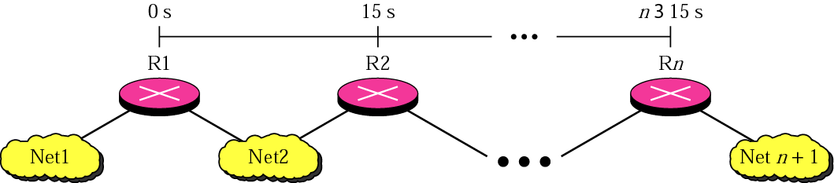
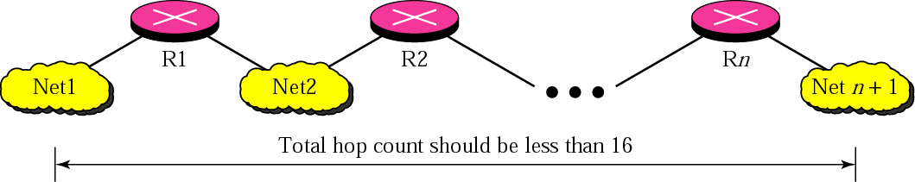
Slow Convergence Problem
Solved by limiting number of hops to 15, 16 means
That the destination is unreachable

Slide 9
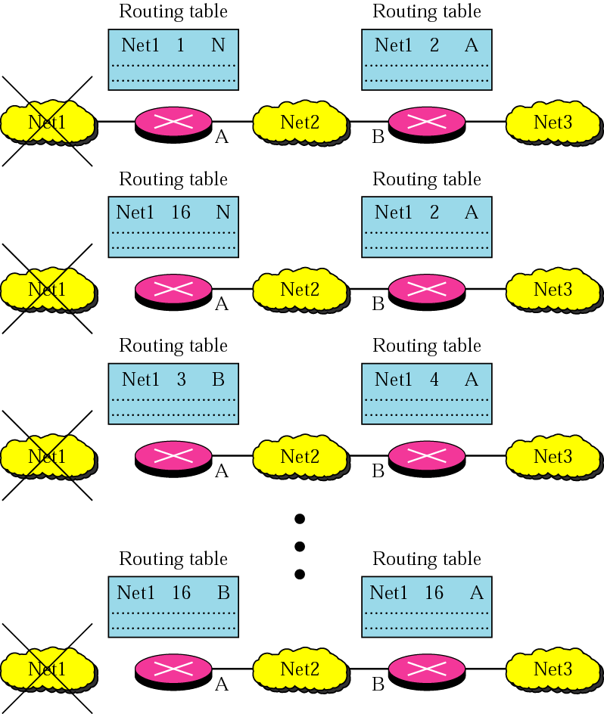
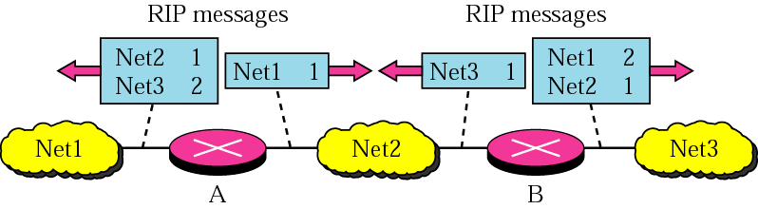
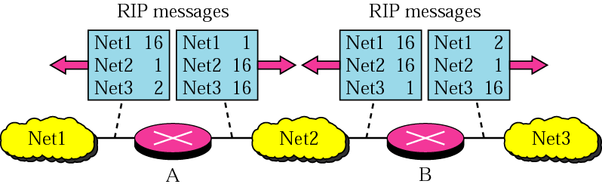
RIP Instability
Triggered Updates
Split Horizons
Poison reverse

Slide 10
Border Gateway Protocol (RFC 1771)
Based on the path vector routing.
Distance-vector protocol not preferred for inter-AS routing (exterior routing protocol)
  Assumes all routers have a common distance metrics to judge route preferences.
    If routers have different meanings of a metric, it may not be possible to create stable, loop free routes.
  A given AS may have different priorities from another AS.
  Gives no information about the ASs that will be visited.
Link-state routing protocol
  Different metrics.
  Flooding is not realistic.
Path vector routing
  No metrics,
  Information about which networks can be reached by a given router and ASs to be crossed.
Differs from DVA
  Path vector approach does not include a distance or cost estimate
  Lists all of the ASs visited to reach destination network.

Slide 11
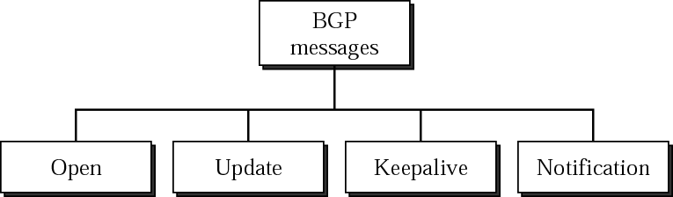
BGP (continued)
Messages are sent over TCP connections on port 179.
Functional procedures
  Neighbor acquisition (open message, acceptance through Keepalive message)
  Neighbor reachability (periodic Keepalive messages)
  Network reachability (broadcast an update message)
    Each routers maintains a database of networks that can be reached
    + preferred route to this network.
RFC does not address
    How a router knows the address of another router.
    Up to network admin.

Slide 12
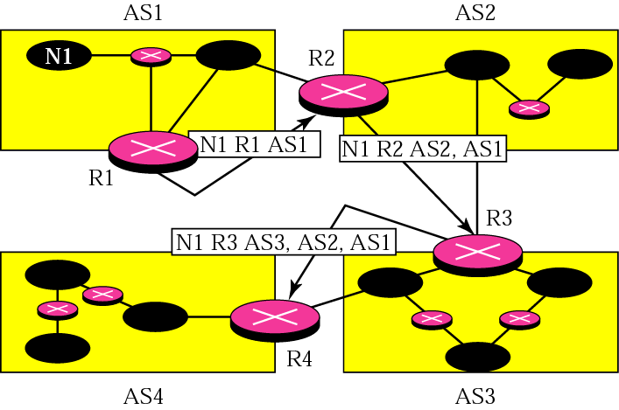
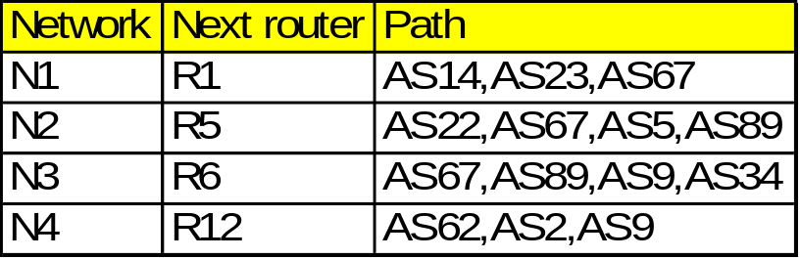
BGP (cont.)
Example of Network Reachability
Example of Message adverstisements
Loop Prevention in BGP:
  Checks the Path before updating its database. (If its AS is in the path ignore the message)
Policy Routing:
  If a path consist of an AS against the policy of the current AS, message discarded.

Slide 13
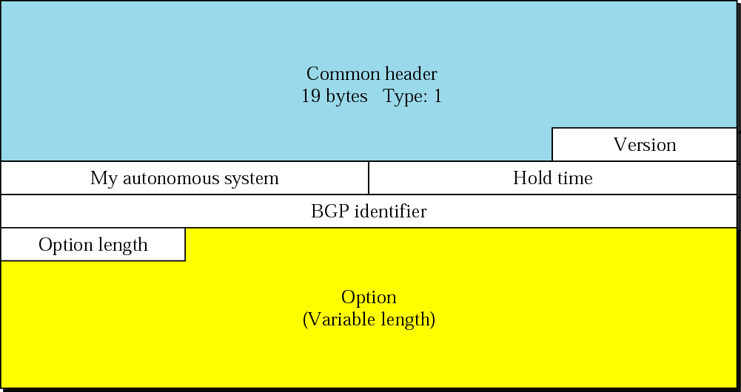
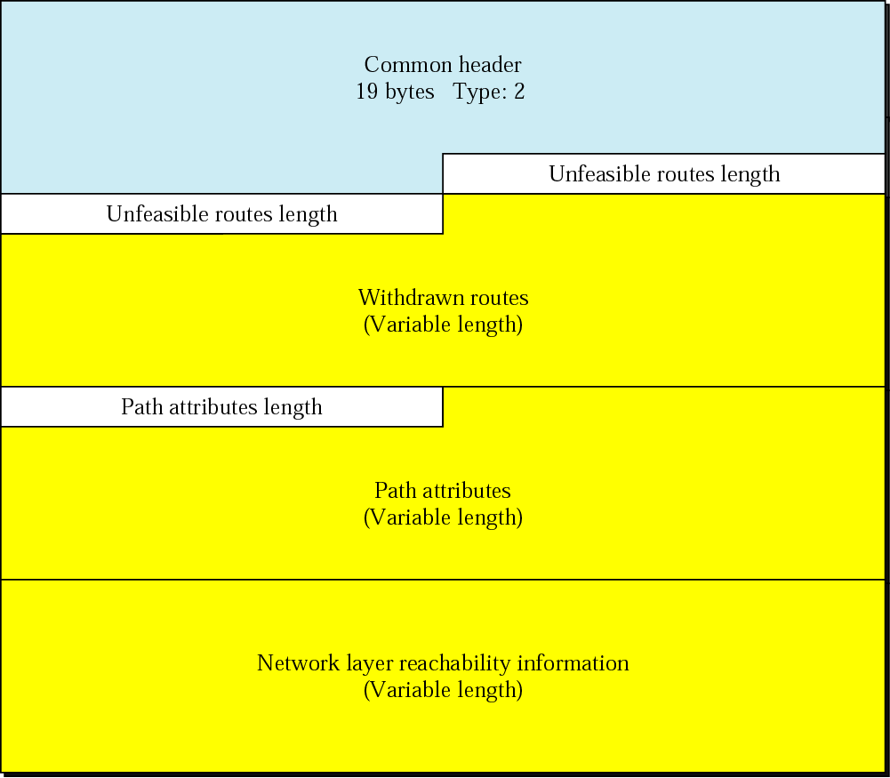

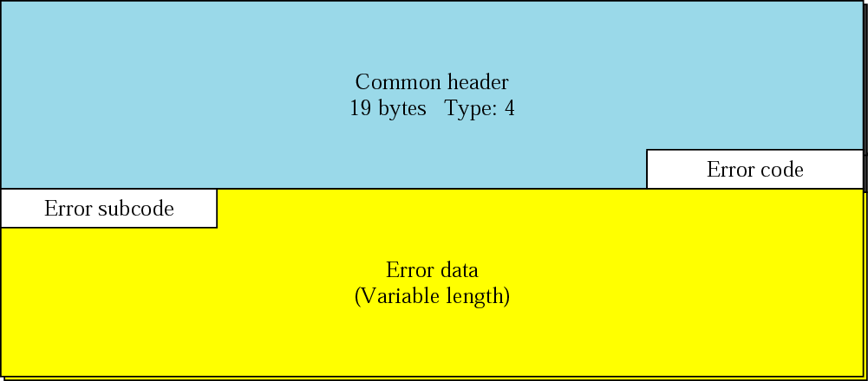
BGP message format (Open, Keepalive, Update, Notification

Slide 14
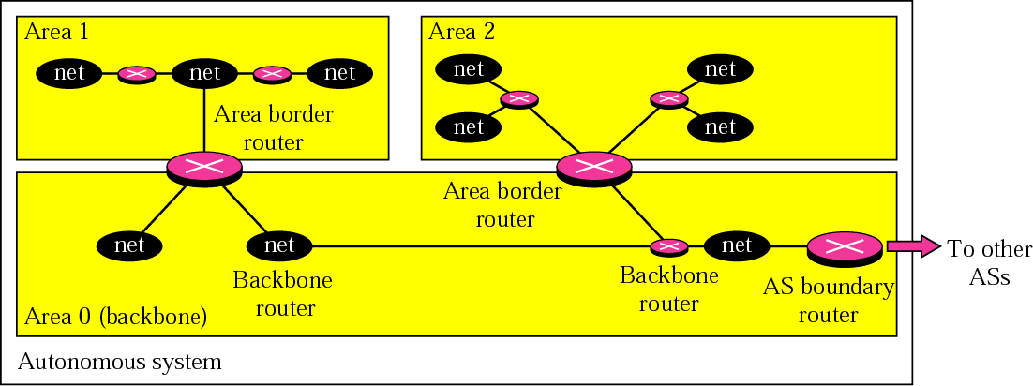
Open Shortest Path First (RFC 1247)
Uses IP, has a value in the IP Header (8 bit protocol field)
Interior routing protocol, its domain is also an autonomous system
Special routers (autonomous system boundary routers) or backbone routers responsible to dissipate information about other AS into the current system.
Divides an AS into areas
Metric based on type of service
  Minimum delay (rtt), maximum throughput, reliability, etc..

Slide 15
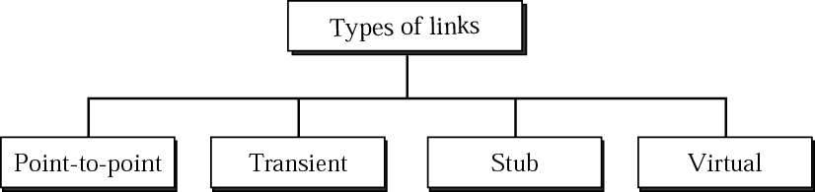
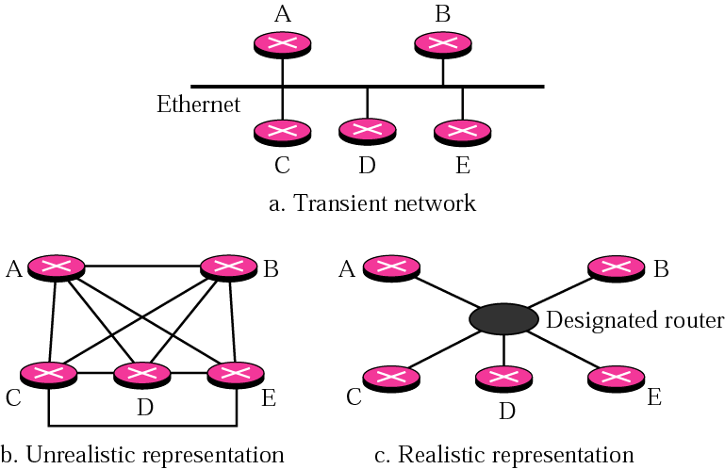
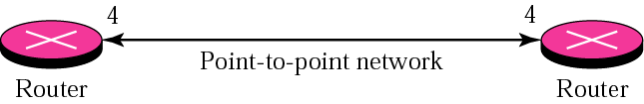
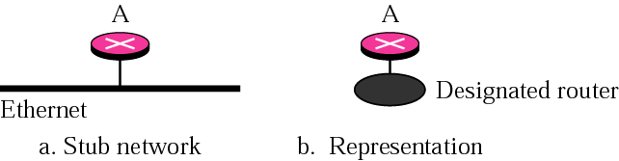
OSPF (type of links)

Slide 16
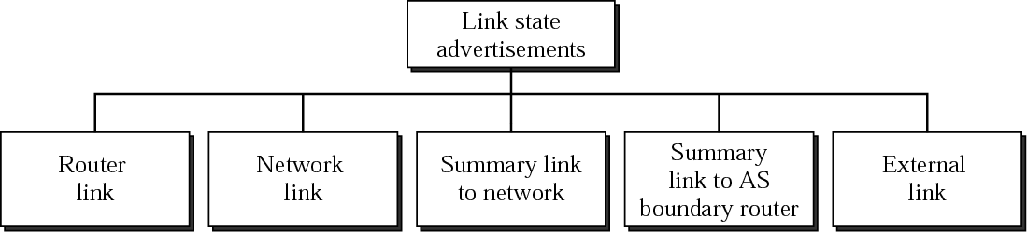
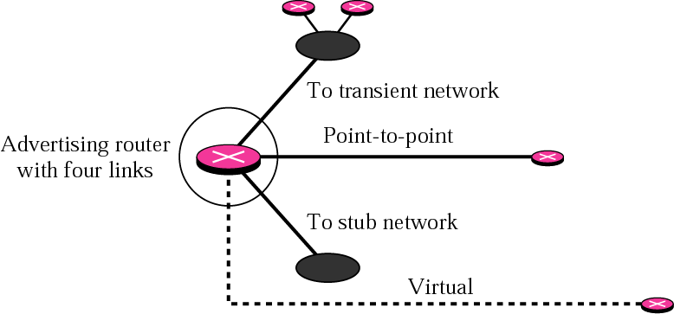
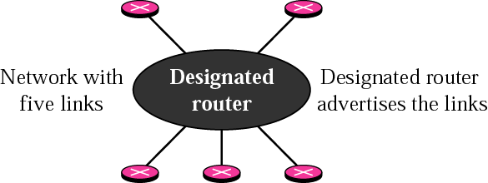
OSPF (link state advertisement)
Network Link
Router Link

Slide 17
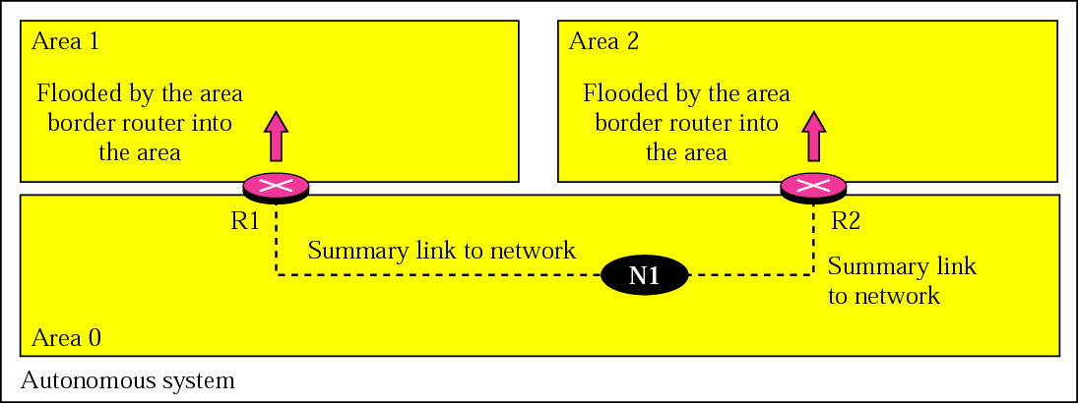
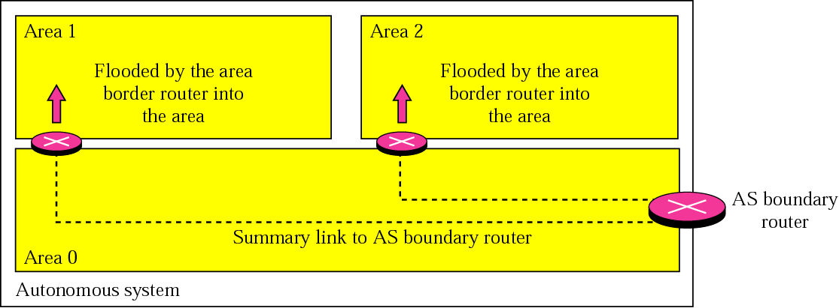
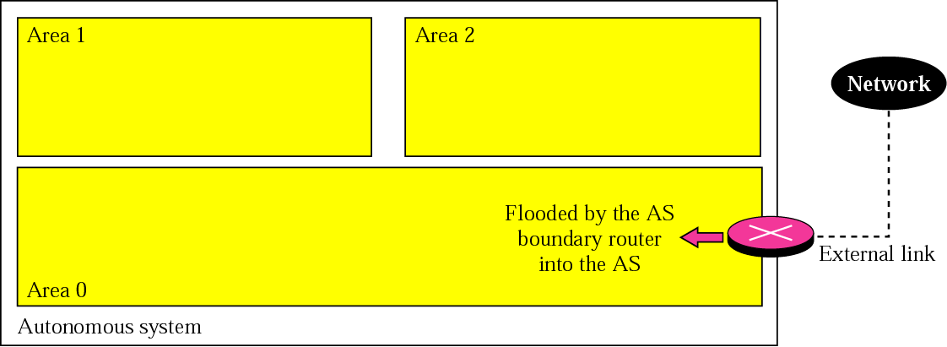
OSPF (LSA cont.)
Summary link to Network
Summary link to AS boundary router
External Link

Slide 18
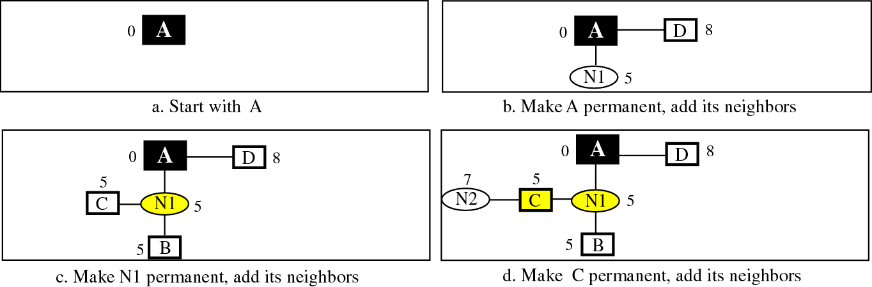
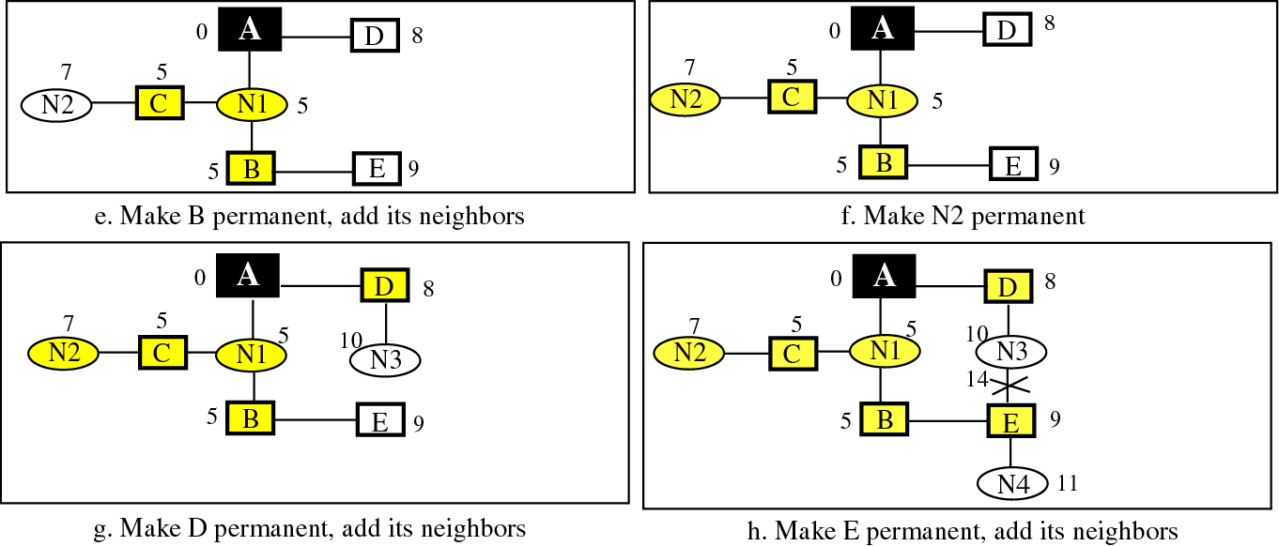
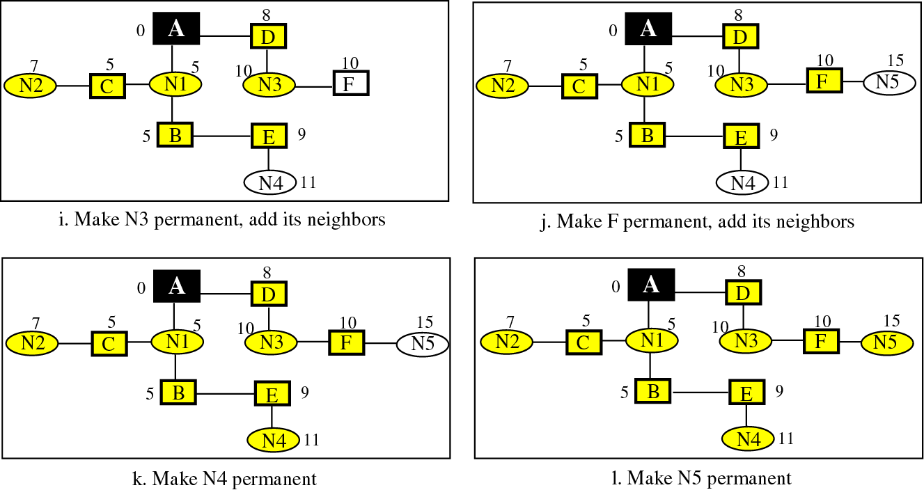
Shortest Path Calculation

Slide 19
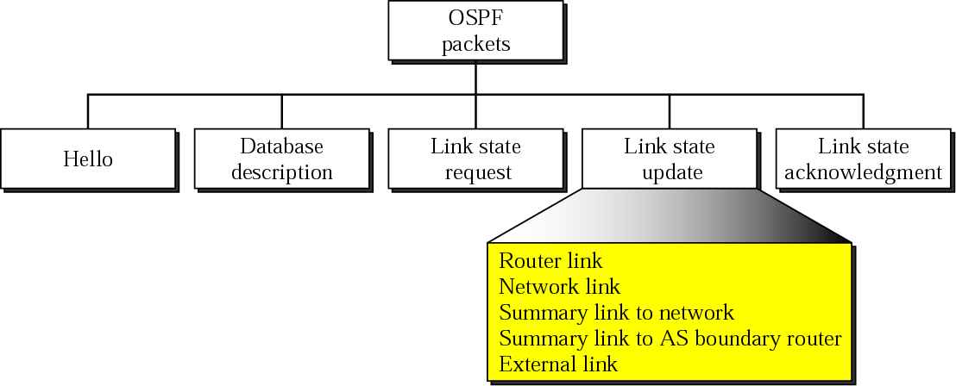
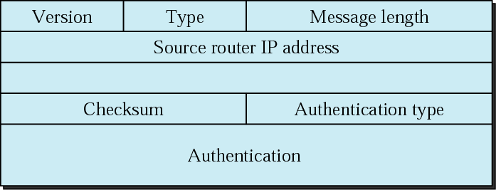
Types of OSPF packets and header format

Slide 20
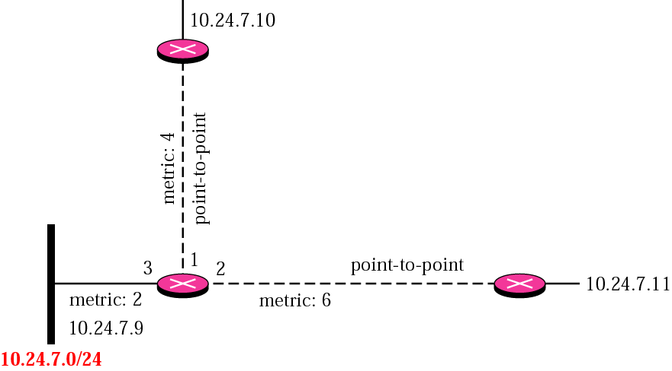
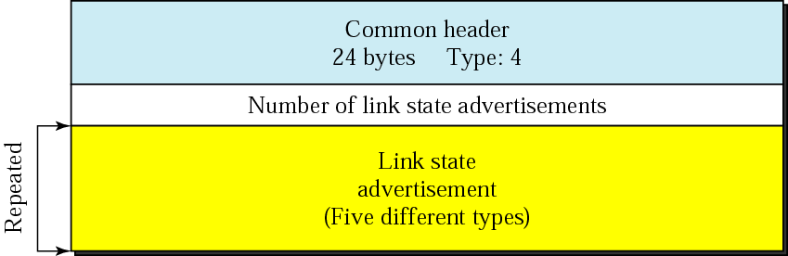
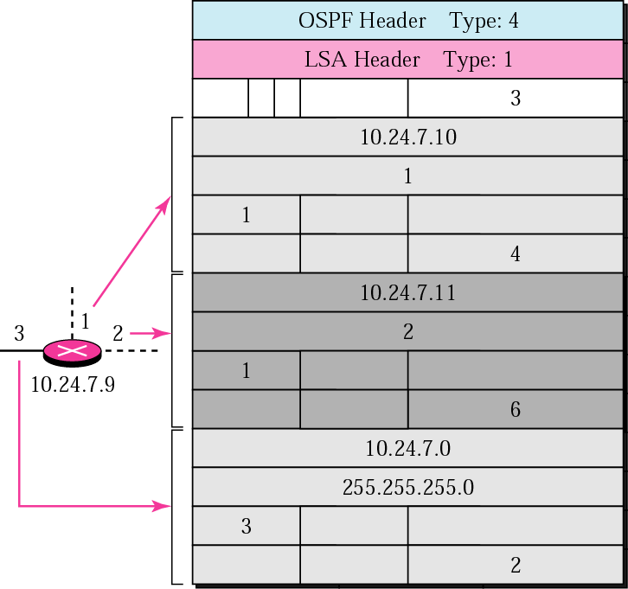
Link State Update Packet
A router link example
LSA header not covered
Refer to RFC 1247

Slide 21
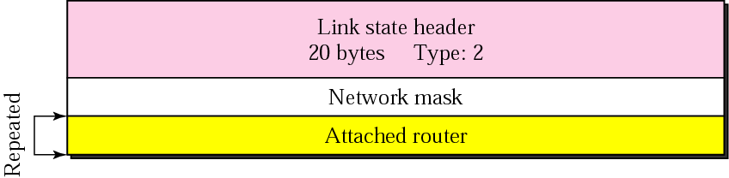

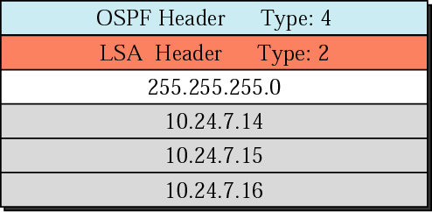
A Network Link Example

Slide 22
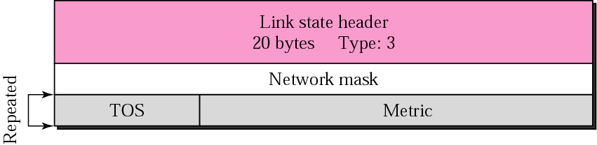

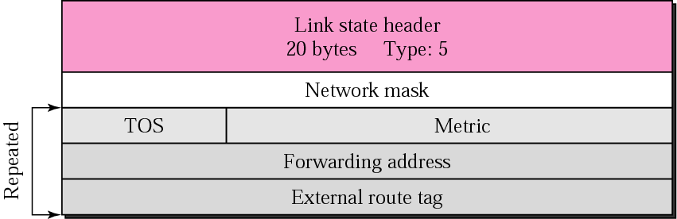
Summary Links state Advertisements
Summary link to network
Summary link to AS boundary
External Link

